Slide 1

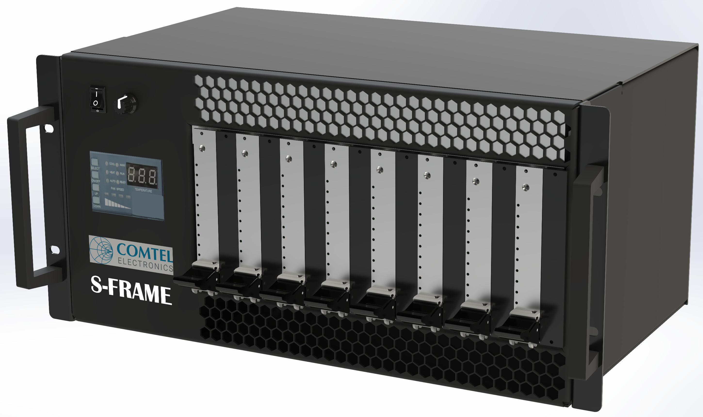
VPX S-Frame - 19" 5U 8 Slot System
PRODUCT DATASHEET
Lab and Deployable VPX Chassis Solution for
19“ Cabinets and Bench Top Applications
For development, testing and final deployment of VPX Conduction Cooled or Airflow Through modules Pluggable to standard VPX 3U slots,
AFT
Configuration
Rugged Sheet Metal Enclosure
For use in 19" Racks or Bench Top with Front to Rear Air Cooling
Interchangeable individual Front Card Slots for:
3U Conduction Cooled ANSI/VITA 48.2
Air-cooled Plug-in Modules ANSI/VITA 48.1
Air Flow Through AFT Plug-In Modules ANSI/VITA 48.5.
Or
Any combination
RTM Card access
Integrated 1500W AC PSU with IEC-320 C14 AC Power Entry
Backplane with Comtel’s high-speed technology for 25Gbps per differential pair is available
Front Panel with Touchscreen display
Air-/-Plane®
COMTEL Electronics GmbH, Phone: +49 89 43 77 89 –0,
Sales: sales@comtel-online.com Web: www.comtel-online.com

Slide 2
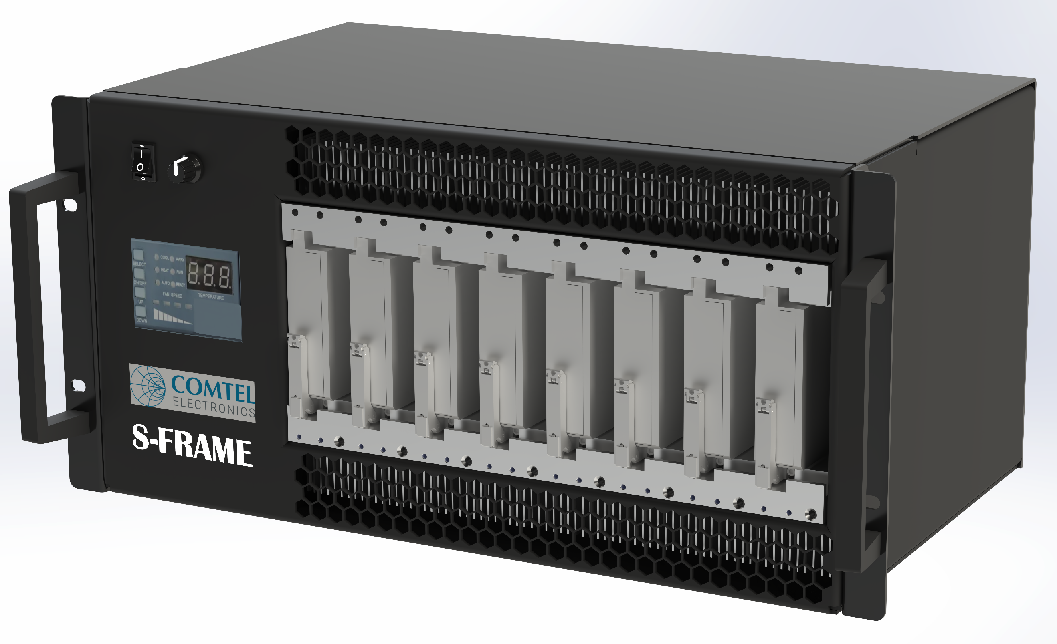
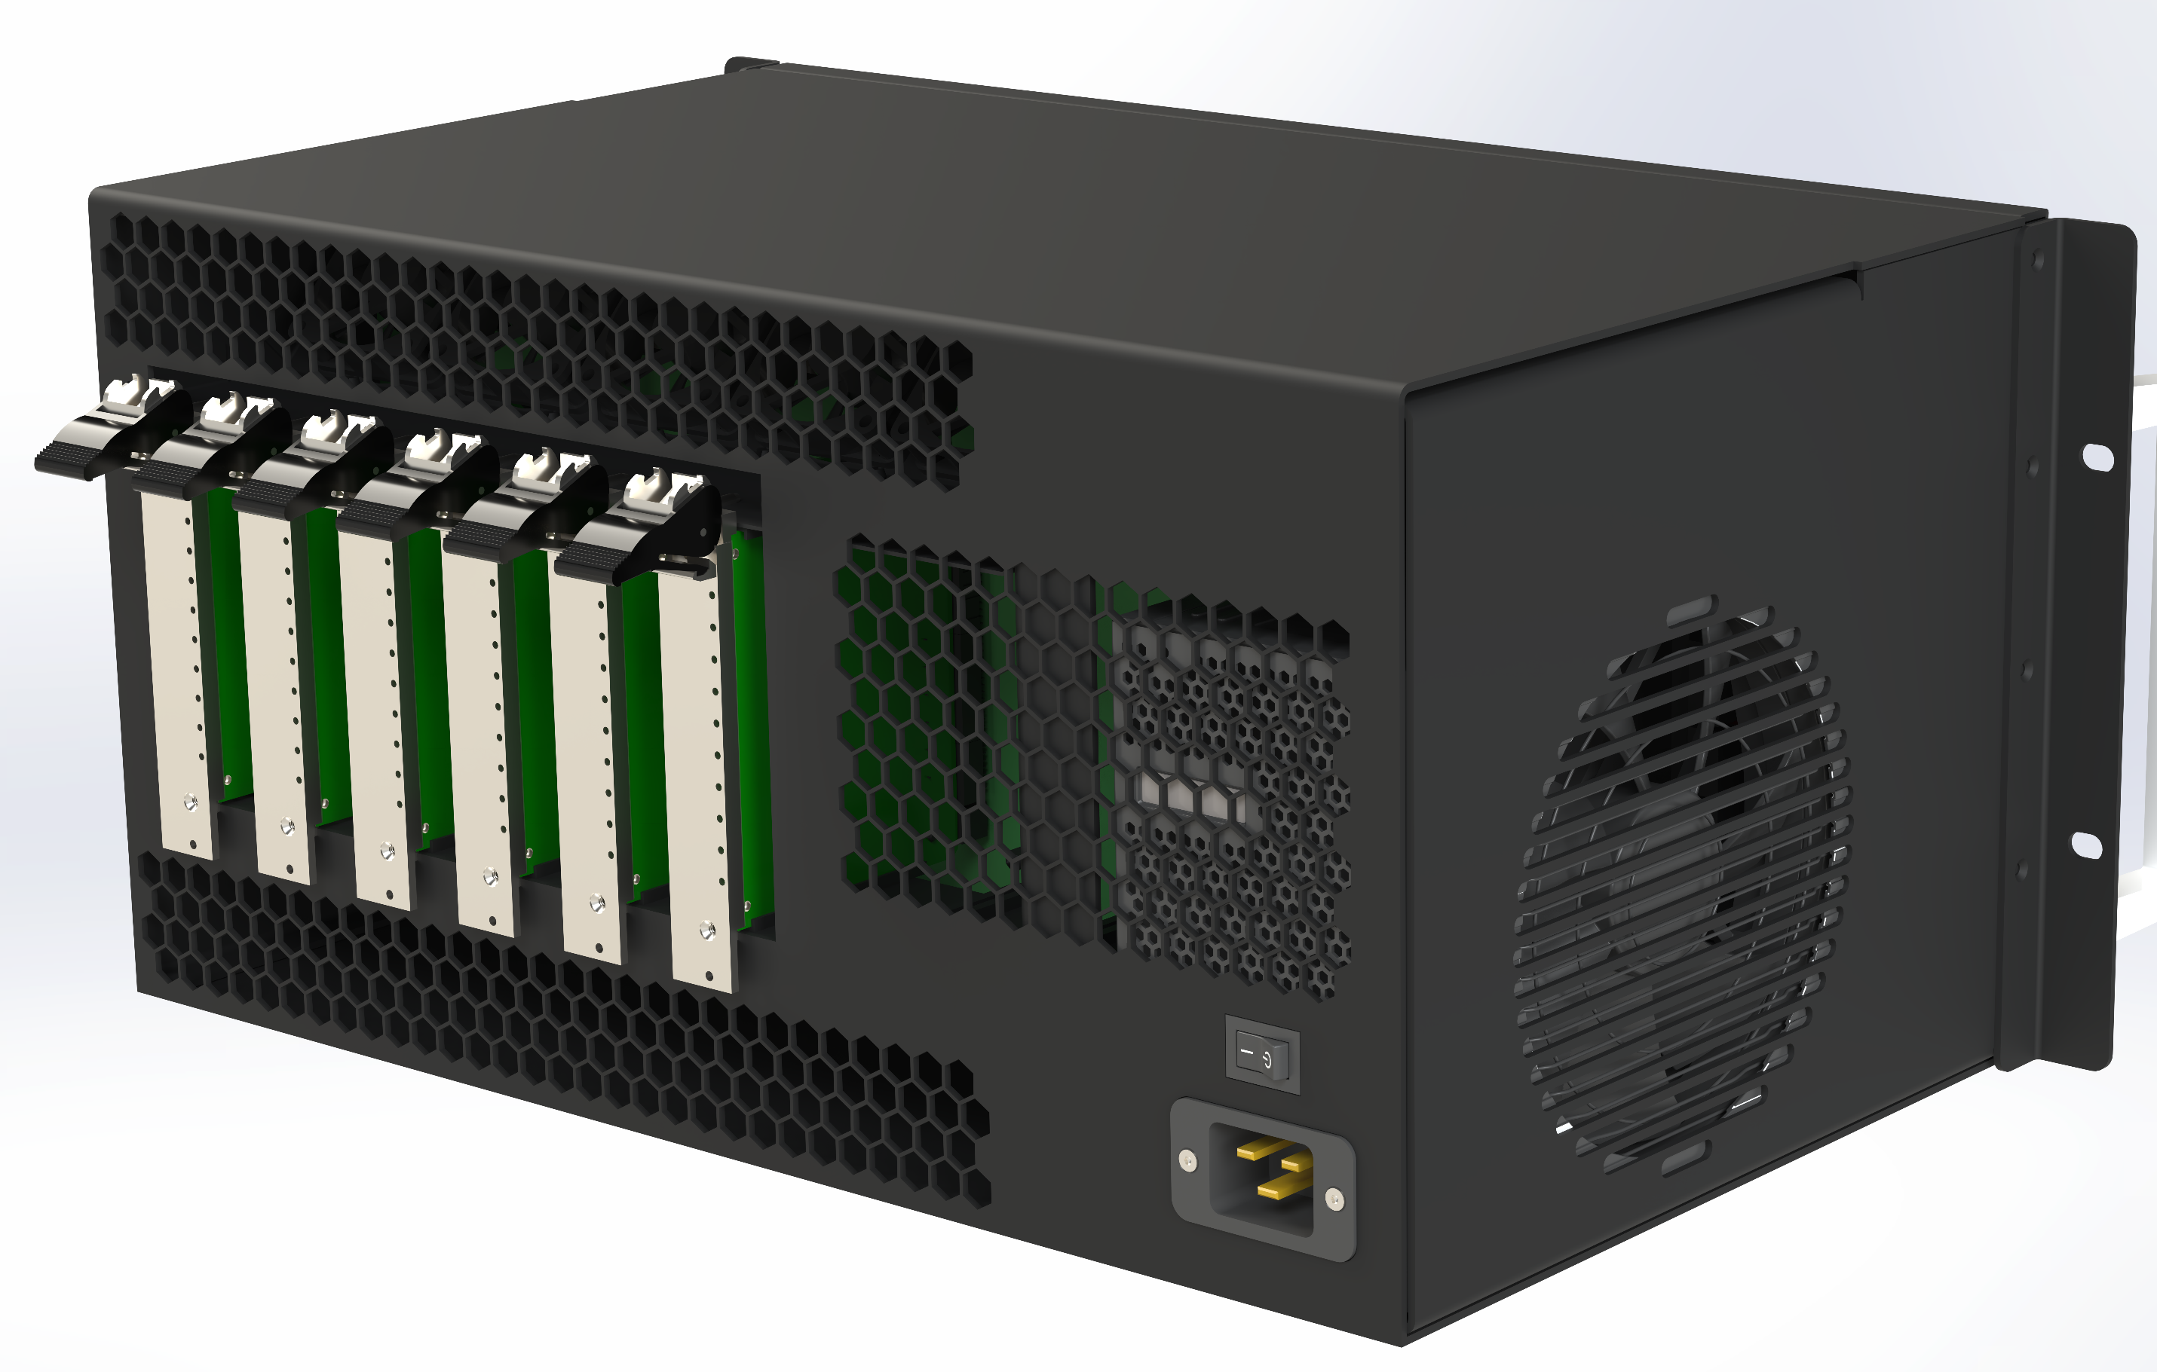
VPX S-Frame - 19" 5U 8 Slot System
PRODUCT DATASHEET
Conduction Cooled
Configuration
Rear view
RTM access
Features
Integrated Backplane:
VITA 46 Compliant
8x 3U Slots with 2" Slot pitch
Comtel’s high-speed Air-/Plane® technology for 25Gbps per differential pair is available
Integrated Power Supply:
Input Voltage: 90-264 VAC
Frequency: 47 – 63 Hz
Input Current
8A for 114VAC, (TBA)
4A for 230 VAC (TBA)
Max. Inrush Current
65A for 114VAC, (TBA)
125A for 230 VAC (TBA)
Power:
Up to 150W per Slot at 25°C ambient
Air Cooling:
Front to Rear
Max. Air Flow: TBA
Noise: TBA
Dimensions (mm):
Width 482.6
Height 222.0 (5U)
Length 270.0 (310.0 with handles)
2” pitch card frame
Environment (default):
Operating temperature 0 to +50°C
Relative Humidity Non-condensing 20-80%
Operation Altitude：5000m

